Slide 1
BCP WALK-THROUGH SESSION IAG -Chennai

Slide 2
AGENDA:
Impact of crisis on the business
What is BCP
Key terms used in BCP
BCP Strategies
Communication cascade
Types of Drills
Q&A

Slide 3
CRISIS AND IT’S IMPACT ON BUSINESS:
The biggest single risk to Business Continuity is the lack of conviction that a risk actually exists !
Survivable
Unexpected Interruption in business operations
Questioned on reliability and judgement
Fines and penalties
Loose business and revenue
Business Impact Assessment
Notes:
Give example when phone battery dies
Then example when crisis hits the business
Normal responses to crisis planning: We are too big to fail
We area covered by insurance
We are not a terrorist target
Things have been fine so far
So basically : it will never happen to me
Reality: Businesses can close down due to the loss of a critical resource for more than 10 days
Companies can loose 75% of their business after a disaster

Slide 4
WHAT IS BCP?
Business Continuity Planning is the planning that is involved to ensure that there is continuity of the critical services.
TCS Policy Directive on Business Continuity activities are detailed in TCS Security Policy(iQMS 2002) and BCM Framework.
Disaster Recovery Plan aims to recover the services completely back to normal.
Notes:
Threats are classified into:
Environment and Natural – Floods, cyclone
Man made – Strike, war
Infrastructure – System crashes, Downtime, Power outages
BCP + DRP = BCM

Slide 5
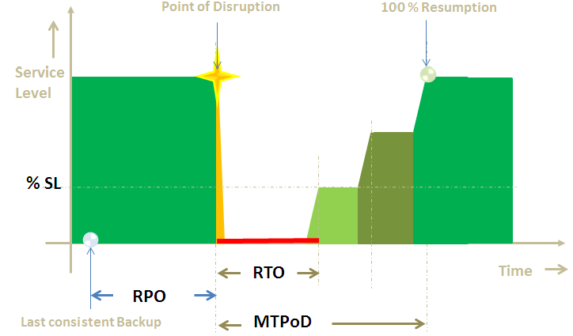
KEY TERMS USED IN BCP:
Outage
Cold Site & Hot Site
RPO (Recovery Point Objective):
RTO (Recovery Time Objective):
MTPoD (Maximum Tolerance Period of Disruption
Notes:
Outage: A period of time when It services are not in operation. 3 diff types.
RTO: duration of time by which a minimum % of Service level has to be restored after a disruption, in order to avoid unacceptable consequences associated with a break in business continuity
RPO: Point in time to which data can be recovered. Eg: an RPO of 30 mins means 30mins of data lost.
MTPoD: Maximum allowable time by when the key products or Services is made 100% available.

Slide 6
BCP STRATEGIES:
Work from Home Strategy
Staff Dispersal Strategy
Work Re-location Strategy
Notes:
Staff Dispersal: Moving associates to an alternate site
Work Re-location: Offloading work to an alternate site.

Slide 7
COMMUNICATION CASCADE:
Operating Unit Level
Account Level
Project Level
RCML
Portfolio Managers
Project Manager
Project Manager
Project Manager
Notes:
Enablers of BCM- who help in smooth and proper deployment of BCM.
There are multiple level designated roles that are established to ensure proper deployment of BCM.

Slide 8
TYPES OF DRILLS:
Call Tree
Work Relocation Simulation / On-site Takeover Simulation
Staff Dispersal
Notes:
Call Tree: A structured cascade method that enables a list of persons to be contacted as part of the invocation procedure.

Slide 9
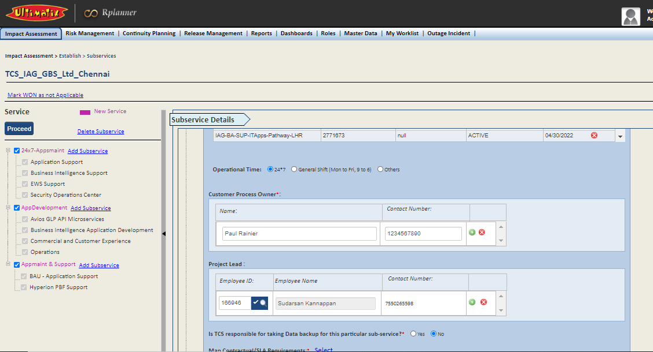
Rplanner
WON and Location tagging could be done here

Slide 10
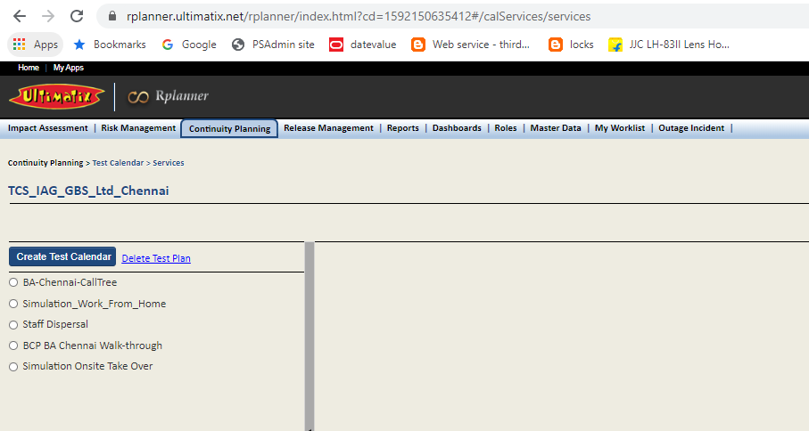
Test Calendar
We could create our own test calendar by using ‘Create test calendar’ option

Slide 11
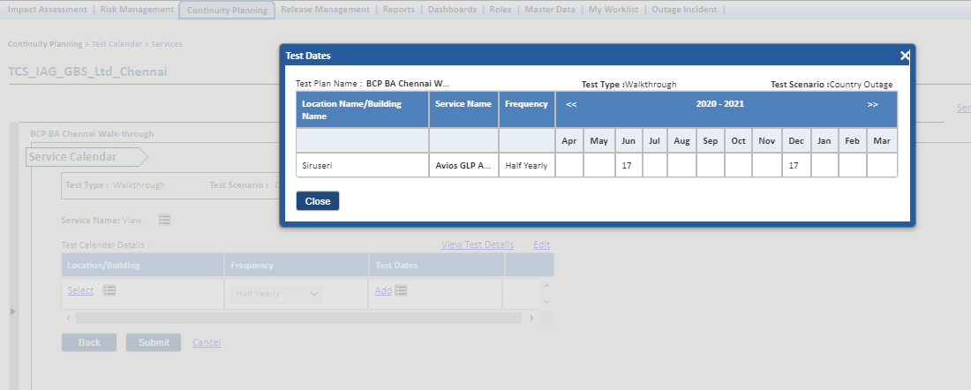
Test Calendar.. Contd..

Slide 12
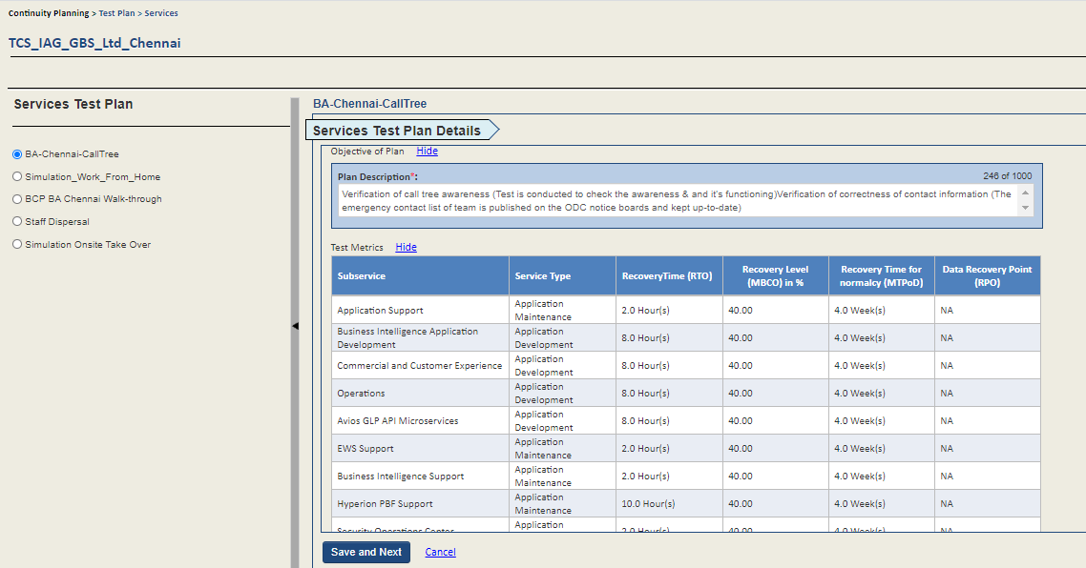
Test Plan
We could define our own test plan or there is a default test plan for all the drills available here

Slide 13
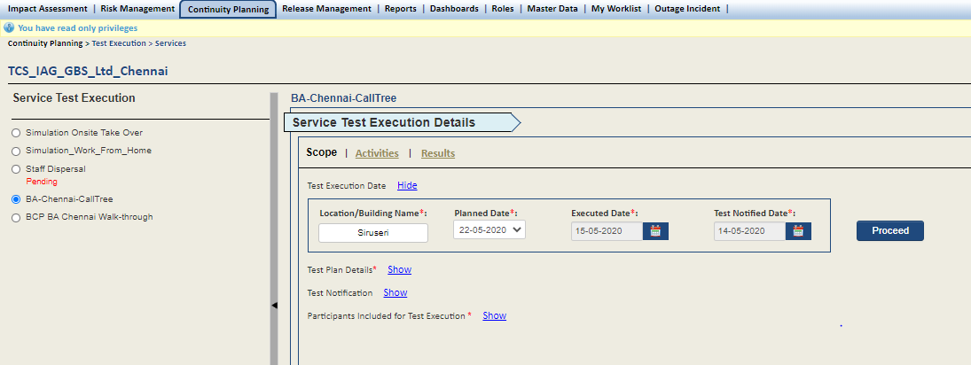
Test Execution – Call Tree
There are multiple Test Execution plans, out of which we are detailing on “Call Tree”.

Slide 14
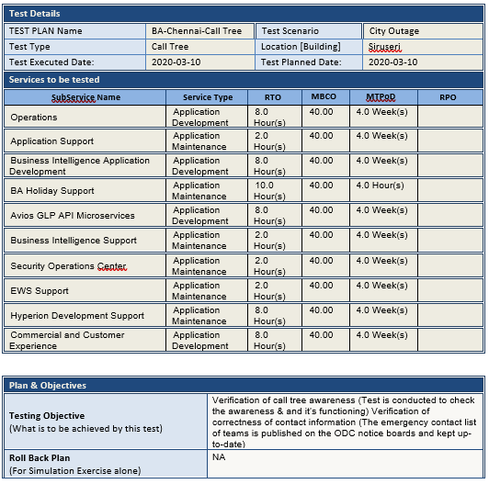
Test Execution – Call Tree Contd..
Test Plan Details

Slide 15
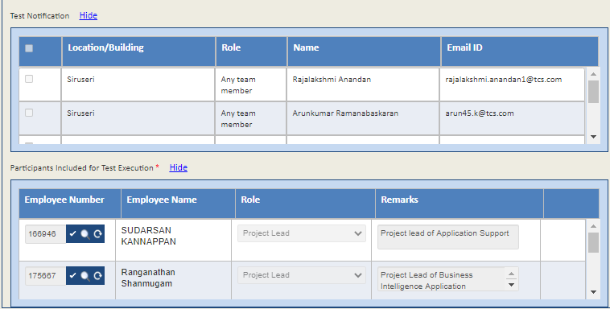
Test Execution – Call Tree Contd..
Test Notification – Mention Users, who needs to be notified about the drill.
Participants Included for Test Execution – Mention Users, who participated in the drill.

Slide 16
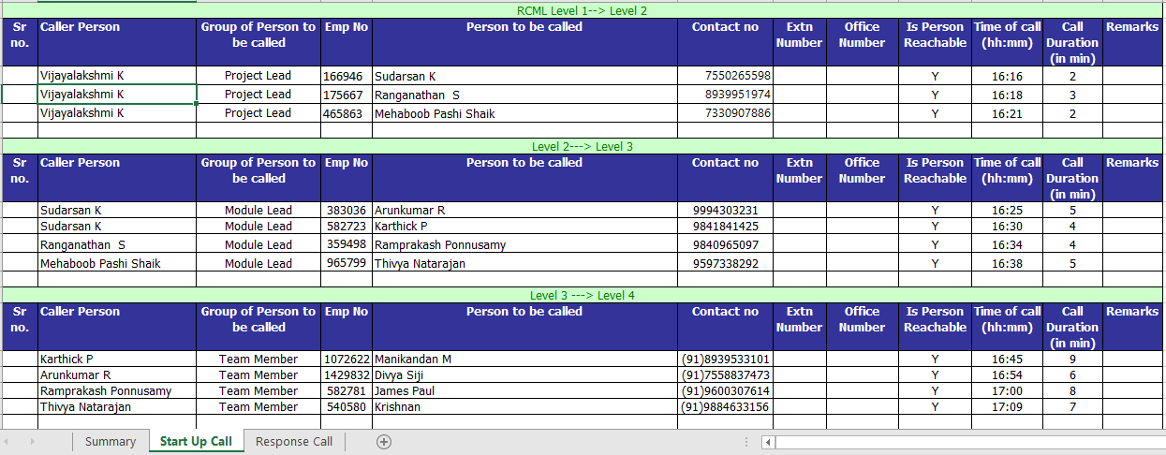
Activity Steps
Start-Up call

Slide 17
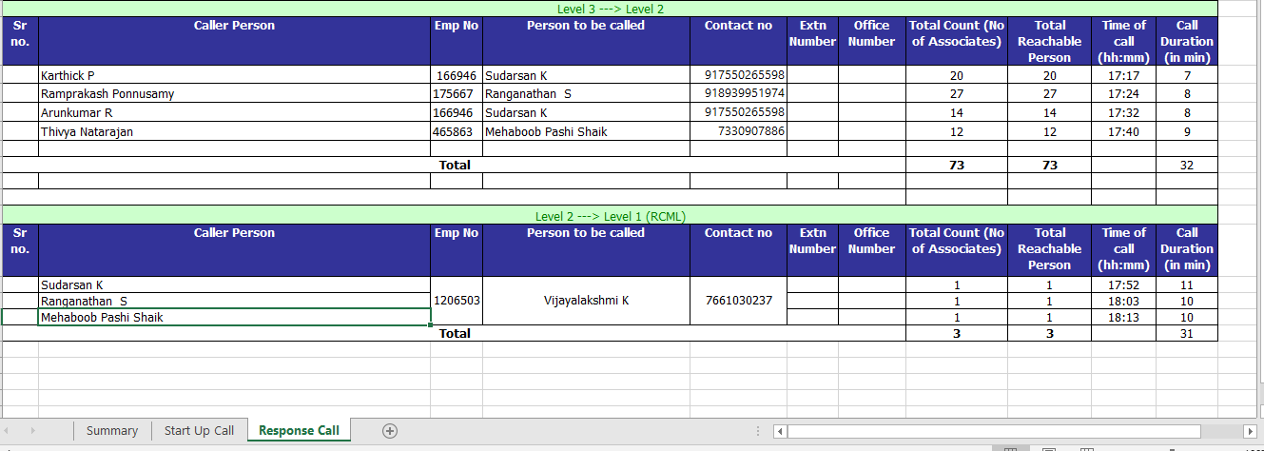
Activity Steps – Contd..
Response Call

Slide 18
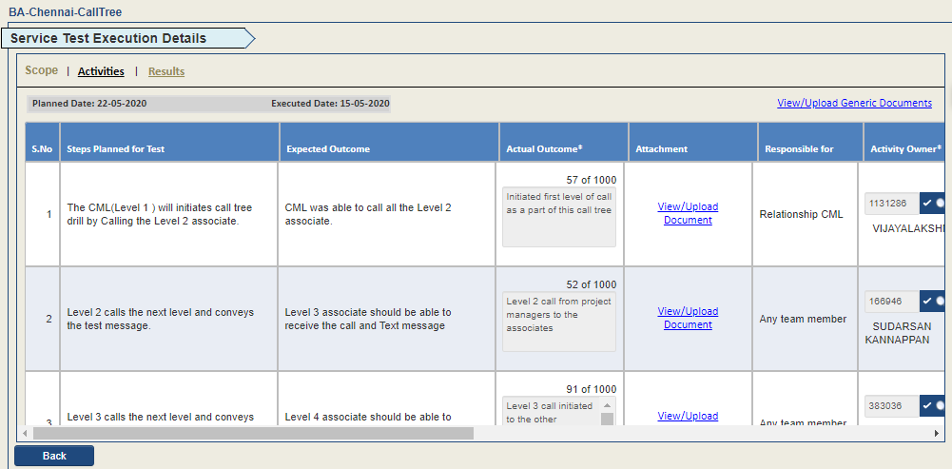
Activity Steps – Contd..
Steps followed in the Start-Up & Response call should be captured as stated below.

Slide 19
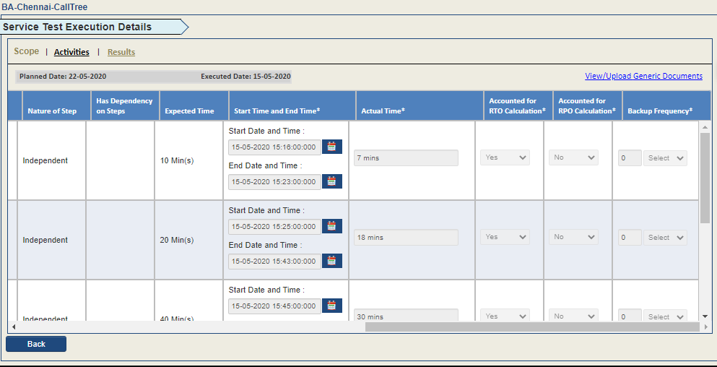
Activity Steps
Real Time Optimization(RTO) – Targeted duration within which a business process must be restored, if any disaster occurs.
RTO would be calculated based on the Actual Time against the Expected Time provided.

Slide 20
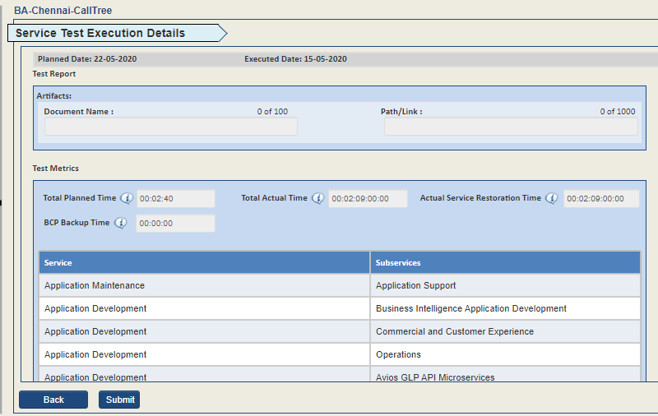
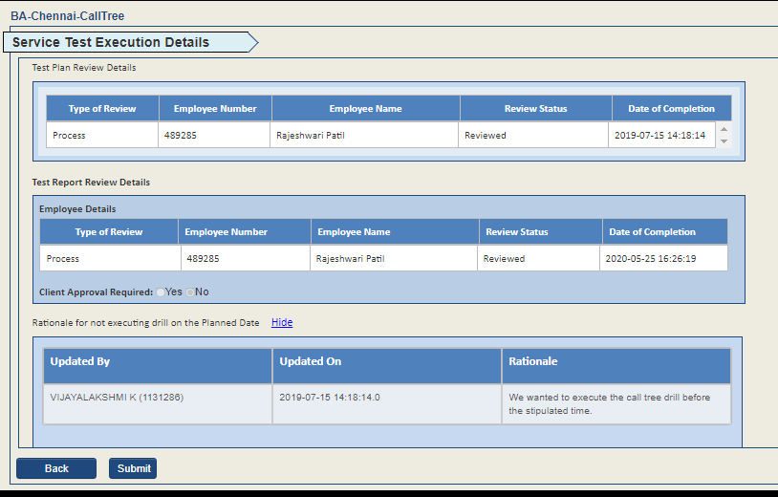
Results

Slide 21
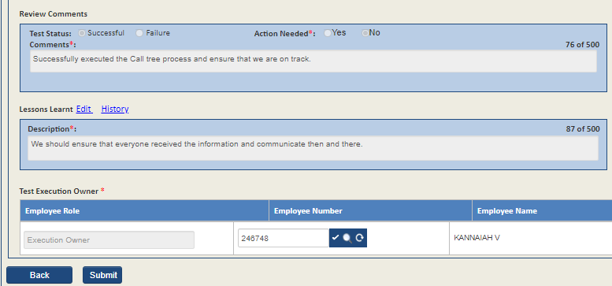

Slide 22
Q&A ??

